Slide 1

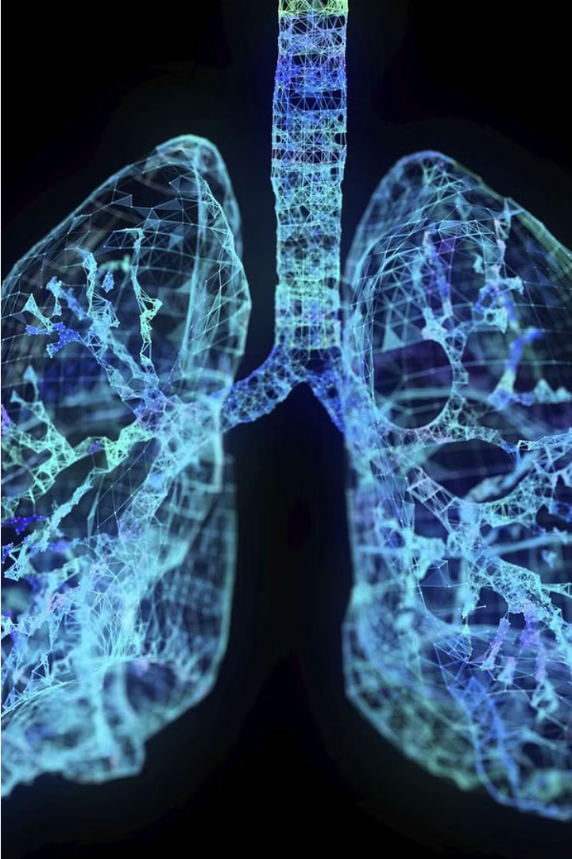
Introduction to Lung Disease Prediction
Lung diseases can have severe consequences if not detected and treated early. This presentation will explore how machine learning can help predict and diagnose lung conditions, enabling proactive healthcare and improved patient outcomes.

Slide 2
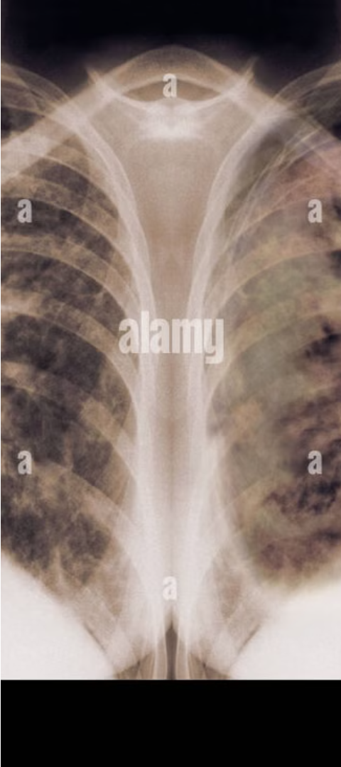
Importance of Early Detection
1
Rapid Intervention
Early detection allows for timely medical intervention, increasing the chances of successful treatment and management of lung diseases.
2
Reduced Complications
Catching lung problems early can prevent the development of more serious complications, improving long-term health outcomes.
3
Improved Quality of Life
Proactive care enabled by early detection can help patients maintain their quality of life and independence for longer.

Slide 3
Data Collection and Preprocessing
Data Sources
Data Cleaning
Feature Extraction
Gather data from various medical imaging techniques, electronic health records, and respiratory function tests.
Ensure data quality by handling missing values, removing outliers, and standardizing formats.
Extract relevant features from the data, such as lung density, airflow patterns, and biomarkers.

Slide 4
Feature Engineering and Selection
1
Feature Importance Analysis
2
Feature Transformation
3
Feature Selection
Select the optimal subset of features to include in the predictive models, balancing model performance and complexity.
Apply techniques like normalization, scaling, and dimensionality reduction to prepare the features for modeling.
Identify the most influential features for predicting lung diseases using techniques like correlation analysis and recursive feature elimination.

Slide 5




Machine Learning Algorithms for Prediction
Decision Trees
Random Forests
Support Vector Machines
Neural Networks
Intuitive and interpretable models that can capture complex nonlinear relationships in the data.
Ensemble methods that combine multiple decision trees to improve accuracy and robustness.
Flexible models that can learn complex patterns in the data and make accurate predictions.
Powerful algorithms that can handle high-dimensional data and identify optimal decision boundaries.

Slide 6
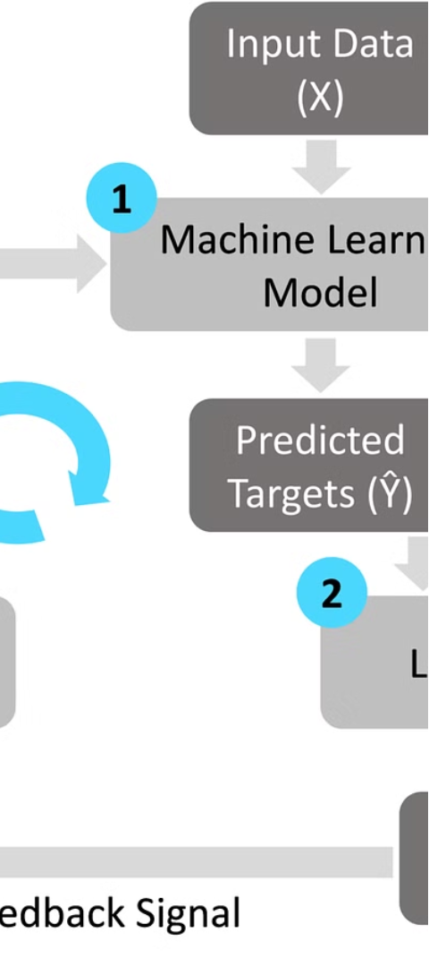



Model Training and Evaluation
Data Splitting
Divide the dataset into training, validation, and test sets to ensure unbiased model evaluation.
Model Tuning
Fine-tune model hyperparameters to optimize performance using techniques like cross-validation.
Performance Metrics
Assess model performance using metrics like accuracy, precision, recall, and F1-score.

Slide 7
Interpreting Model Outputs
Prediction Probabilities
Feature Importance
Understand the model's confidence in its predictions, which can guide clinical decision-making.
Identify the key factors driving the model's predictions, providing insights into the underlying disease mechanisms.
Uncertainty Quantification
Clinical Integration
Assess the reliability of model outputs and communicate the level of confidence to healthcare providers.
Integrate the predictive models into clinical workflows to support healthcare professionals in making informed decisions.

Slide 8
Conclusion and Future Directions
1
Ongoing Research
2
Multimodal Integration
Continued development of more accurate and interpretable machine learning models for lung disease prediction.
Combining diverse data sources, such as imaging, genomics, and clinical records, to improve predictive performance.
3
Personalized Medicine
4
Ethical Considerations
Leveraging machine learning to enable individualized risk assessment and tailored treatment plans.
Addressing issues of privacy, bias, and transparency in the deployment of these predictive models.

Slide 9
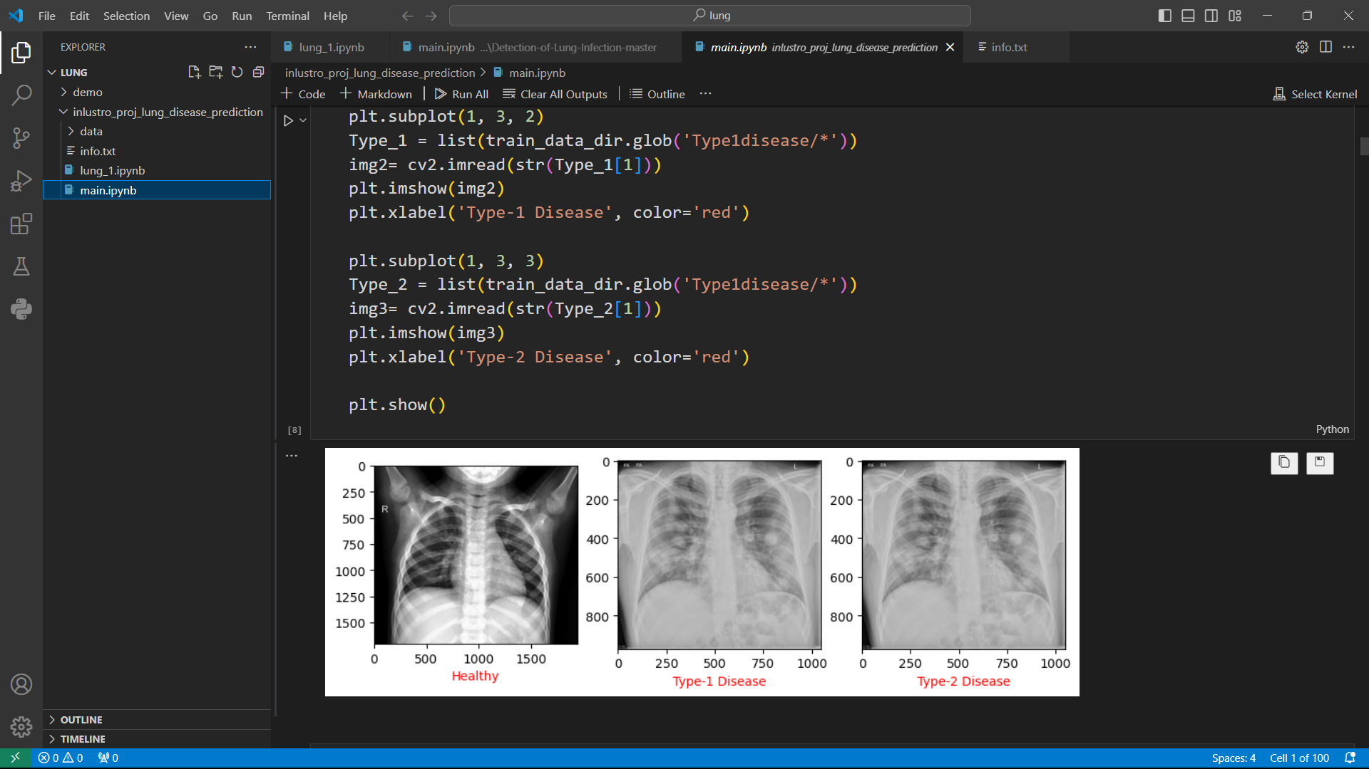
OUTPUT:

Slide 10

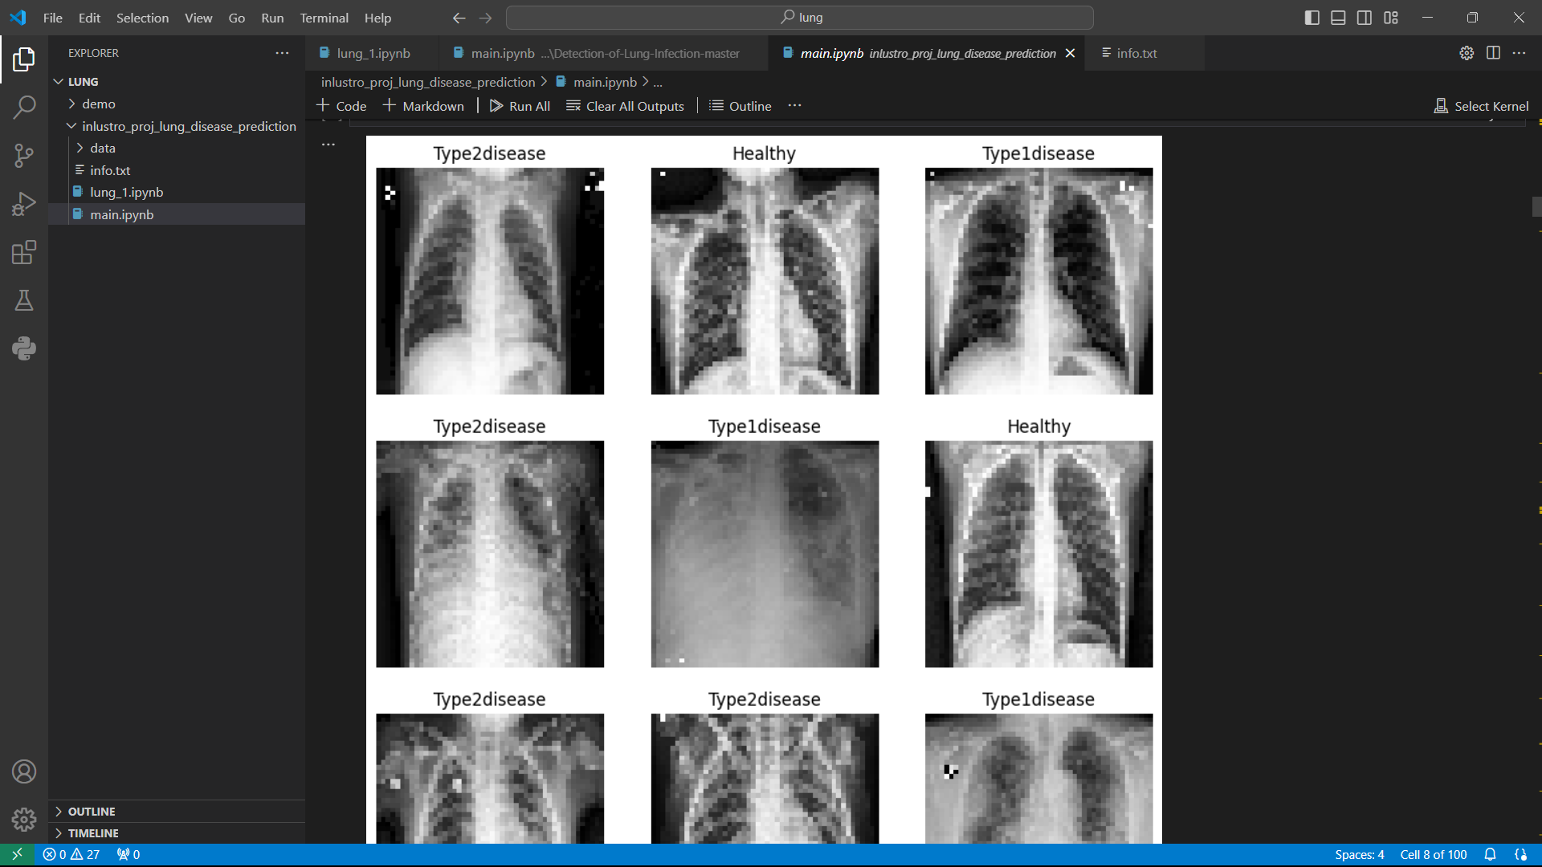
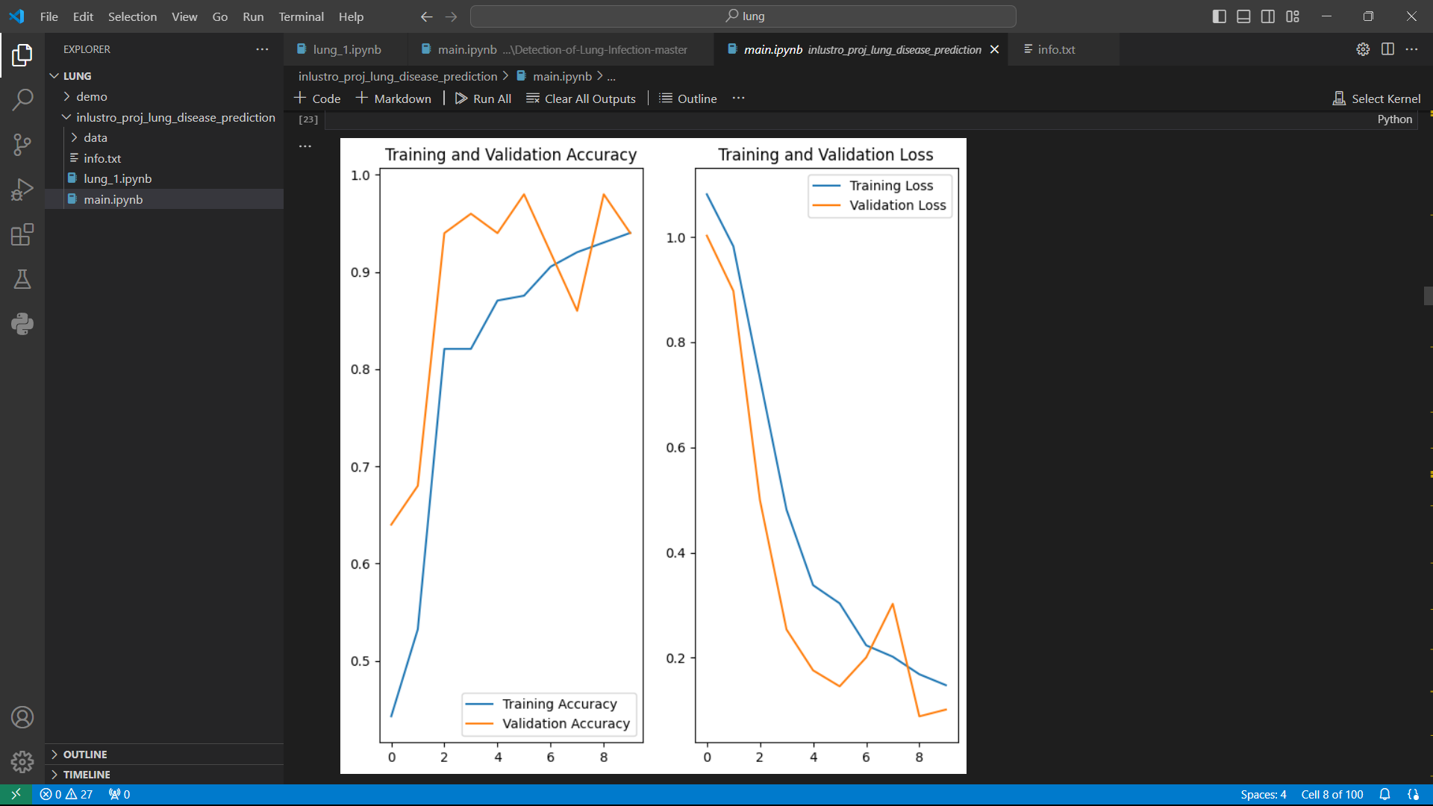

Slide 11
